Slide 1
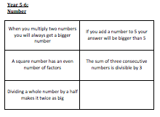
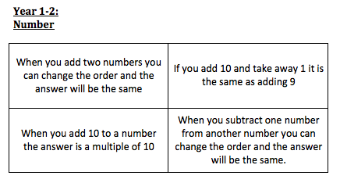
Always, Sometimes or Never?
Notes:
Give a range of packs of cards to each table and ask them to explore. Use a pack of cards with your partner and sort into the three headings. When ready on your table, rotate round so that each pair has a new arrangement to look at and discuss whether you agree or not. (15mins)

Slide 2
Always, Sometimes or Never?
KS1 Number and Shape (12671)
“Four-sided shapes are called squares”
Always, Sometimes or Never?
KS2 Number (12672)
“Multiples of 5 end in a 5”
Notes:
Put up and ask to discuss on tables, referring to progression of reasoning.
Examples of things they might hear in a classroom. Illustrate proof by counter example when it arises.
Repeat the sorting of your set and then moving on to critique another once more, paying particular attention to opportunities for proof by counter example. (10mins)

Slide 3
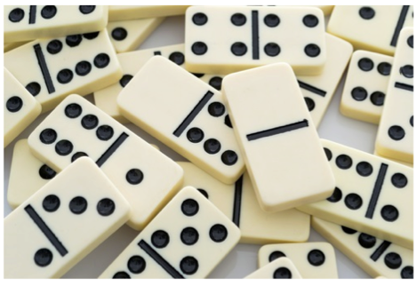
Amy’s Dominoes (1044)
Amy has a box containing ordinary (0-6 spot) dominoes but she thinks it might not be a complete set.
She has 24 dominoes in her box and there are 125 spots on them altogether. Which dominoes is she missing?
Notes:
7-11 (**)

Slide 4
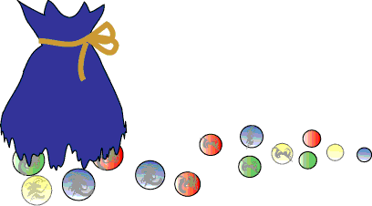
Andy’s Marbles (2421)
Andy and his friend Sam were walking along the road together. Andy had a big bag of marbles.
Unfortunately the bottom of the bag split and all the marbles spilled out. Poor Andy!
Notes:
7-11 (**)
Give out sheets
Deliberately chosen because it’s tricky (two stars on website) and to examine the ps process (link to Y4 ‘solve problems involving increasingly …’)
Have a go, consider what doing at each of four stages

Slide 5
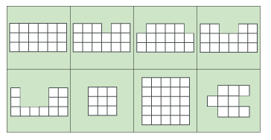
Area and Perimeter (7280)
What can you say about each of the shapes below?

Slide 6
Can you draw:
a shape in which the area is numerically equal to its perimeter?
a shape in which the perimeter is numerically twice the area?
a shape in which the area is numerically twice the perimeter?
Can you make:
the area of your shape go up but the perimeter go down?
the perimeter of your shape go up but the area go down?
Can you draw some shapes:
that have the same area but different perimeters?
that have the same perimeter but different areas?

Slide 7
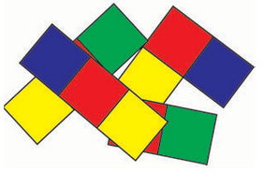
Arranging Cubes (6973)
The aim of the task:
The team has to recreate a 2-D arrangement of cubes which matches all the information on their cards without showing each team member's information to anyone else.
Notes:
The codification here is about the problem solving skills illustrated during the doing of the task by different groups, drawing on examples of good reasoning (particularly justificiation) and collaborative skills.

Slide 8
Arranging Cubes cont. (6973)
Rules:
Team members cannot show their cards to anyone else on the team.
A team member can describe what is on each of their cards.
Team members can ask questions to help them make sense of what is on their cards, or on someone else's cards.
The task is complete when everyone agrees that the arrangement they have made matches everything that is on their cards.
Observer role:
Check that no one reveals their card or writes anything down.
Identify points where team members share knowledge and reasoning, and listen to each other.
Identify points where team members make decisions together.
Note whether all members of the team are involved.

Slide 9
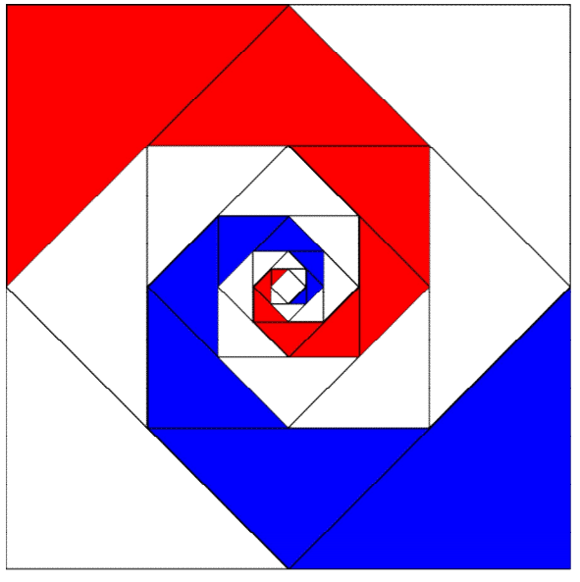
Baravelle (6522)
Notes:
Taster Show image: give one minute to look at ON THEIR OWN to familiarise themselves with it.
Chat to neighbour about what they saw.
Image back for further min and can chat.
Re-create image.
Further questions –how could you continue the image inwards or outward?

Slide 10
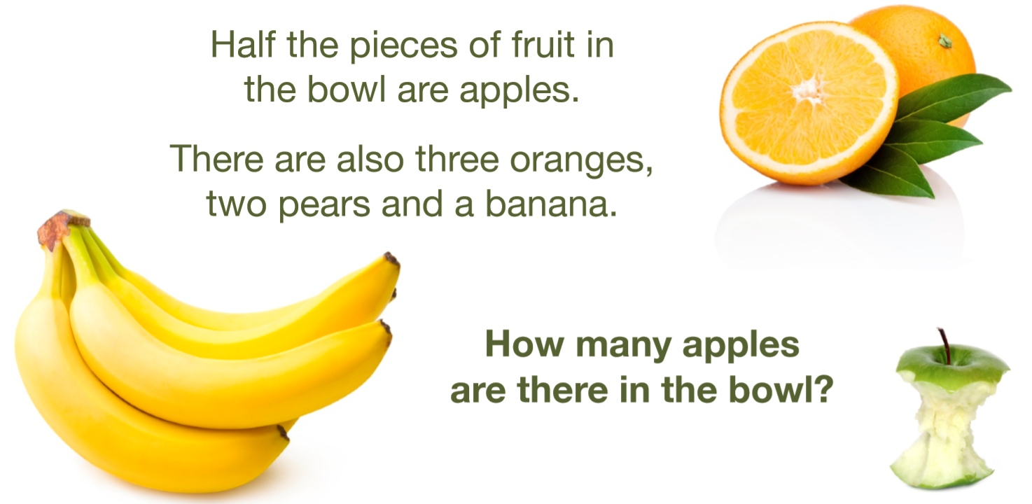
A Bowl of Fruit (218)
Notes:
Have a look at the task on tables, how would you introduce it?
Take some feedback
Create two or three similar problems using language of halves, quarters and thirds (link Y2)
What misconceptions/difficulties might your children experience with this type of challenge? (record on big sheet of paper with spaces)
Swap sheets - how would you support these misconceptions?
Rotate one more time to add further thoughts.

Slide 11
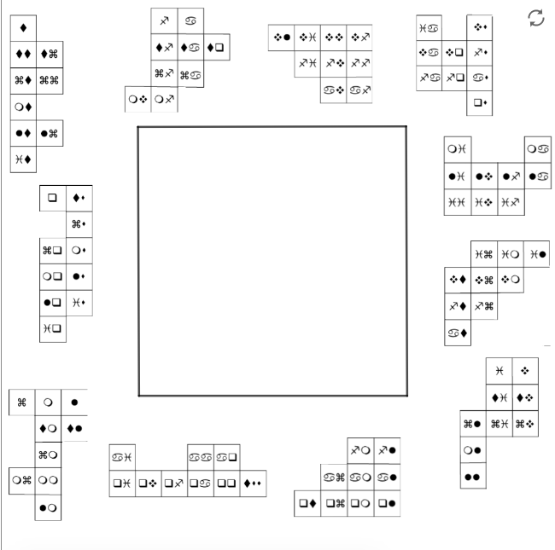
Coded Hundred Square (6554)
This hundred square is written in code. It starts with 1 and ends with 100.
Can you piece it together?
Notes:
Have a go at task then consider structure of problem-solving process. How did what you did to tackle the task fit in with the four-stage process suggested?
NB Going further in this context could be about convincing yourself and others that your solution is correct

Slide 12
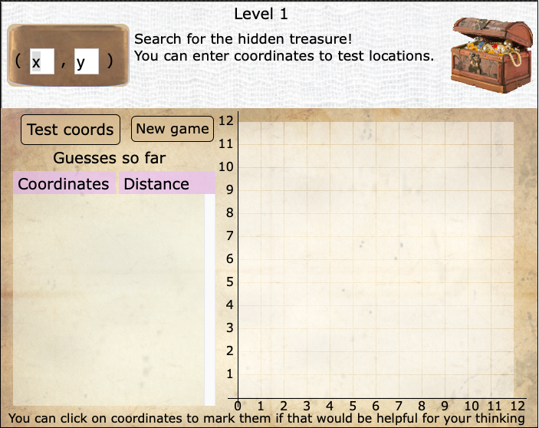
Treasure Hunt (6288)

Slide 13
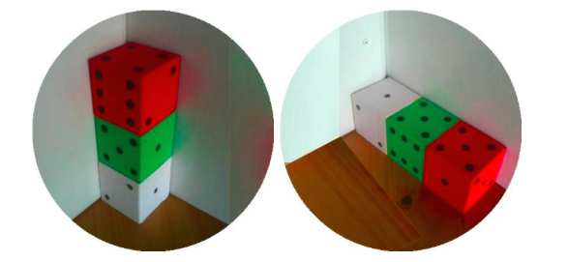
Dice in a corner (8586)
Notes:
This one has a good high ceiIing

Slide 14

Dicey Addition (11863)
Find a partner and a 0-9 dice.
Each of you draw an addition grid like this:
Take turns to throw the dice. After each throw of the dice, you each decide which of your cells to put that number in.
Throw the dice four times until all the cells are full.
Whoever has the sum closer to 100 wins.

Slide 15
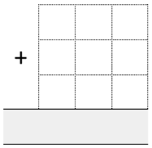
Dicey Operations (6606)
Find a partner and a 0-9 dice.
Each of you should draw an
addition grid like this:
Take turns to throw the dice and decide which of your cells to fill. You must fill a cell before throwing the dice again.
Each time the dice is thrown, you both use that number in one of your cells.
When you have filled all nine cells, whoever has the sum closer to 1000 wins.
Notes:
NB remind delegates about id numbers
Have a go
Have a second go

Slide 16

Dicey Operations in Line (13261)
Find a partner and a 0-9 dice.
Each of you should draw an addition grid like this:
Take turns to throw the dice and decide which of your cells to fill. You must fill a cell before throwing the dice again.
Each time the dice is thrown, you both use that number in one of your cells.
When you have filled all nine cells, whoever has the sum closer to 1000 wins.
Notes:
NB remind delegates about id numbers
Have a go
Have a second go

Slide 17
Domino Sets (9965)
How could you check if you have a full set of 0-6 spot dominoes?
What about a full set of 0-9 spot dominoes?

Slide 18

Dotty Six (7337)
3
4
2
1
5
3
5
1
2
Yellow wins!
nrich.maths.org

Slide 19
Doughnut Percents (6945)
How to play
Players pass cards to other team members in order to help one another complete their set.
Rules
No one can talk or give non-verbal signals to other members of the team.
Each member of the team starts with four cards in front of them.
The cards in front of each person should be visible to everyone.
Team members can only give cards; they cannot take cards from someone else.
Each team member must have at least two cards in front of them at all times.
Notes:
Draw out particular group skills that the task demanded

Slide 20
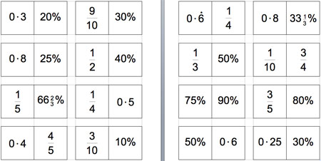
Doughnut Percents (6945)

Slide 21
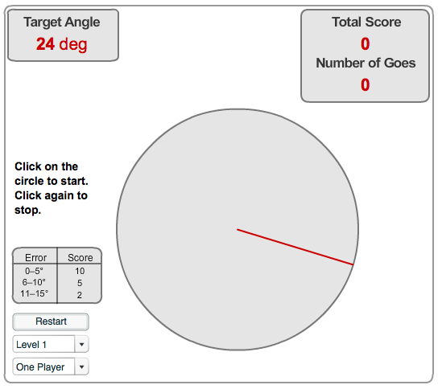
Estimating angles (1235)

Slide 22
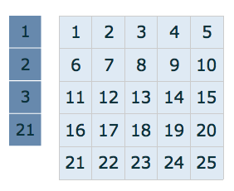
Factor Lines (1138)
Arrange the four number cards (1, 2, 3 and 21) on the grid to make a diagonal, vertical or horizontal line.
You can put a number card on a square with
  the same number
  a multiple of that number
  a factor of that number.
How many different solutions can you find?
Notes:
How would we engage all learners? This rich task might need differentiating for different children e.g. through different grid, different number cards NB same processes for all children though
Digging deeper – convincing others that you have all the different ways (see later in session for proof)
Landmarks?
Processes in terms of the rope: procedural fluency, adaptive reasoning, productive disposition (in terms of being determined)

Slide 23
Factors and Multiples Game (5468)
This is a game for two players.
The first player chooses a number on the grid and crosses it out.
The second player chooses a number to cross out. The number must be a factor or multiple of the first number.
Players continue to take it in turns to cross out numbers, at each stage choosing a number that is a factor or multiple of the number just crossed out by the other player.
The first person who is unable to cross out a number loses.

Slide 24
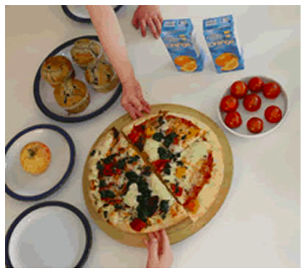
Fair Feast (2361)
Here is a picnic that Petros and Michael are going to share equally.
What will each of them have?
Notes:
Think about other food types – choose something that you would like to bring to the picnic and how it would be shared.
Link to ‘Maths Story’ in Early Years section

Slide 25
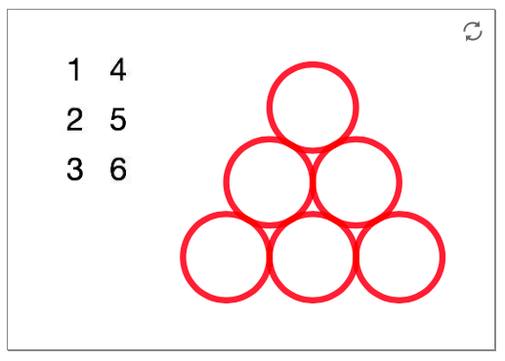

Find the difference (6227)
Place the digits from 1 to 6 in the circles below so that each number is the difference between the two numbers just below it.

Slide 26
Five Steps to 50 (10586)
This challenge is about counting on and back in steps of 1, 10 and 100.
Roll a die twice to establish your starting number - the first roll will give you the tens digit and the second roll will give you the ones digit.
You then make five jumps to get as close to 50 as possible. You can jump forwards, or backwards, in jumps of 1 or 10 or 100.
Notes:
Have a go several times, discuss what noticed as whole group
Really nice context for proof. Exploring further examples means that strategies might emerge which always work, which is the essence of a generalisation). Generalisation involves identifying the underlying structure.
WHY YOU CAN’T DO 56? WHAT’S THE POINT OF 100?
I think all numbers with digits the same are possible…oh no you can’t do 44!

Slide 27
Fraction Match (6938)
How to play
Players pass cards to other team members in order to help one another complete their set
Rules
No one can talk or give non-verbal signals to other members of the team
Each member of the team starts with four cards in front of them
The cards in front of each person should be visible to everyone
Team members can only give cards; they cannot take cards from someone else
Each team member must have at least two cards in front of them at all times
Notes:
Have a go at Fraction Match and Doughnut Percents – see next slide (latter includes fractions, decimals and percentages)
Draw out particular group skills that the task demanded
See further slides for image of actual cards

Slide 28
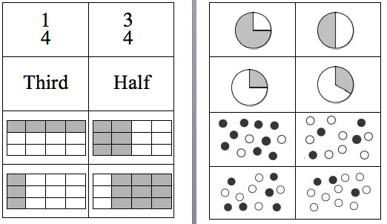
Fraction Match (6938)

Slide 29
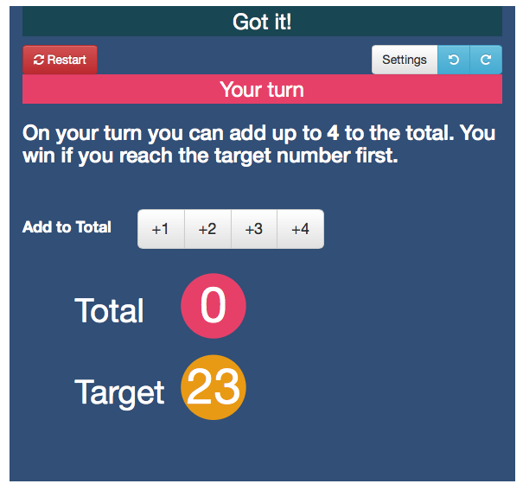
Got it! (1272)

Slide 30
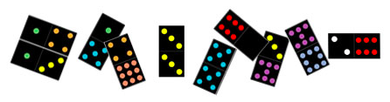
Guess the Dominoes (6995)
The team has to find the rule on the Ruler's card, using the minimum number of tests. A test is asking whether a particular domino obeys the rule.

Slide 31
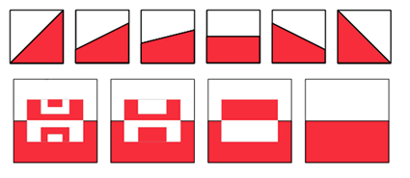
Halving (1788)
These images show squares split in half:
How could you check that each was correct?
Can you think of more ways to split a square into two halves?
Notes:
Recognise, find, name a half (Y1)
Have a quick look at this, don’t spend long actually doing it as it links closely to session 1 task
Show how to find it via the id number on the website and show where Teacher’s Resources are to be found and their format.

Slide 32
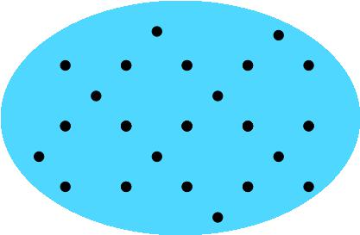
How Would We Count? (8123)
Notes:
Give out sheets
How many dots?
How did you count them?
How did your neighbour count them?
Working systematically
Focus on communication in this instance
Number sense?

Slide 33
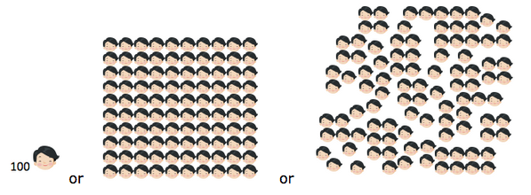
If the World Were a Village (7725)
In this village, there are 100 people:
Which representation do you prefer and why?
Notes:
Good to demonstrate curiosity
Fran and Bernard to bring copies of book
See also teachers’ notes for this activity, and next slide

Slide 34
If the World Were a Village cont. (7725)
How could you represent the following, or other data from the book:
76 have electricity, 24 do not.
82 have access to a source of safe water either in their homes or within a short distance. 18 do not and must spend a large part of each day simply getting safe water. Most of the work of collecting water is done by women and girls.
Notes:
Invite pairs/tables to choose a set of data and have a go at representing it
Nice opportunity to draw attention to the teachers’ notes
Share other books which provide discussion prompts – Fran to bring

Slide 35
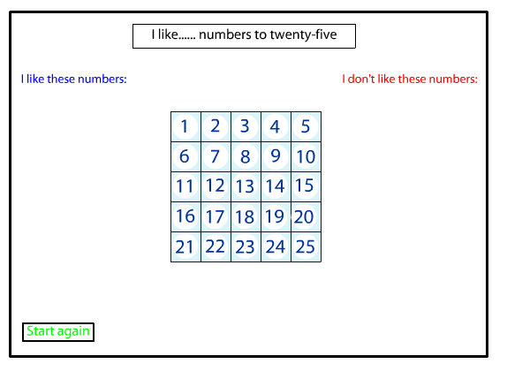
I Like… (6962)
Notes:
Testing conjectures

Slide 36
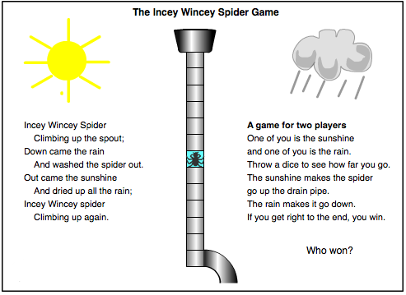
Incey Wincey Spider (8863)

Slide 37
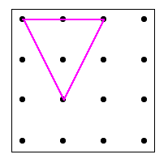
Inside triangles (5648)
I have joined three dots to make a triangle which has one dot inside it.
How many different triangles with one dot in the middle can you draw?
How do you know you’ve found them all?

Slide 38
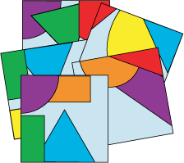
Jig Shapes (6886)
Share all the cards out amongst the group.

Slide 39
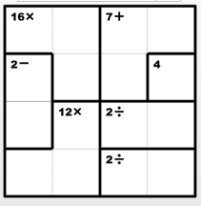
Ken Ken Puzzles
What do you think?
What could you guess?
What questions would you like to ask?
Notes:
Explain you’re going to do a think, pair, share activity. So the first few moments will be for them to consider their own ideas about the questions you’re going to put up.
Then they can talk to someone near them, before sharing ideas with the whole group.
Dimensions of grid mean using digits 1-4 inclusive
Sudoku rules apply – no repeated digits in a single row or column, or in a darkly outlined area
Give out a range of Ken Kens and invite them to take it in turns to fill in a digit and tell their partner why.
Feedback?

Slide 40
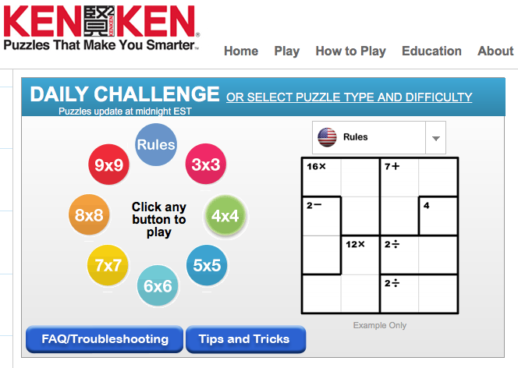
www.kenkenpuzzle.com

Slide 41
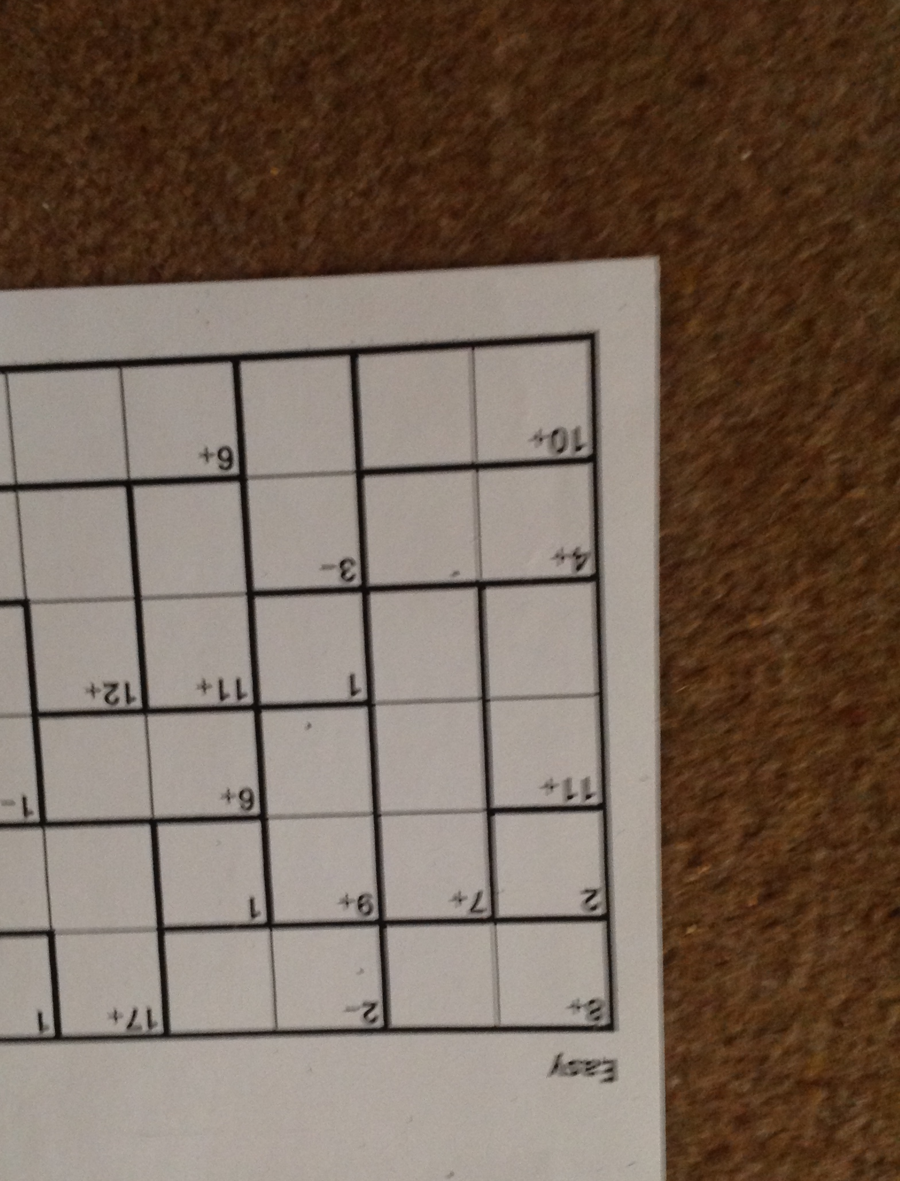
Notes:
NEED VIDEO
Give time to look at ken ken on screen – and point out the ‘dog leg’ top right, which they will hear referred to in the clip.
Play video (up to 2:48) ask participants to look out for examples of novice and expert reasoning (10mins)

Slide 42
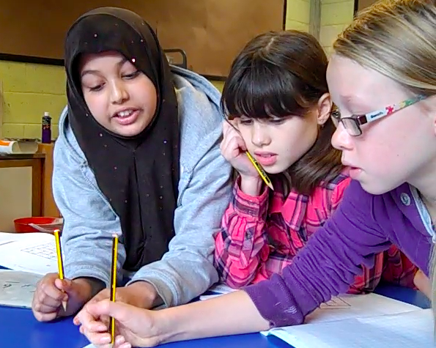
Notes:
Put up whilst delegates talk about what they saw
Take feedback
(Minor point, but the labelling of the grid as ‘Easy’ could be unhelpful.)

Slide 43
Lots of Lollies (2360)
Frances and Rishi were given a bag of lollies.
They shared them out evenly and had one left over.
Just as they had finished sharing them their friends Kishan, Hayley and Paul came along. They wanted some lollies too, so the children shared them out again between all of them.
This time they had two lollies left over.
How many lollies could there have been in the bag?
Notes:
Introduce as in teachers’ notes – give time to think about task for a few minutes (not necessarily reach full solution) then give out cards to illustrate different ways of starting task. Invite participants to choose one starting point and take it to a full solution (suggest each pair on a table chooses a different starter) STARTING POINTS CARDS
Different ways of articulating generalising in this task – numbers ending in 7, odd numbers that are two more than a multiple of 5 …

Slide 44

Magic Vs (6274)
Place each of the numbers 1-5 in the V shape so that the arms of the V have the same total.
How many different possibilities are there?
How could you convince someone that you have found them all?
Notes:
Look at digging deeper and how this fits – how would you engage the lower attainers in the task?
Investigate proof by exhaustion by exploring all the possibilities.

Slide 45
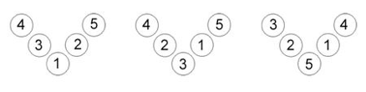
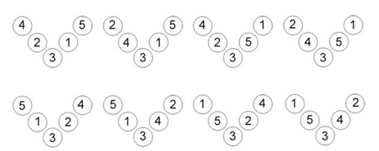
Finding them all
Notes:
Discuss what makes an unique solution
What’s the reasoning that goes with this?

Slide 46
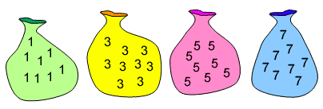
Make 37 (1885)
Four bags contain a large number of 1s, 3s, 5s and 7s.
Pick any ten numbers from the bags above so that their total is 37.
Notes:
Participants will try the task. We will circulate and look for examples of those further along the reasoning progression to draw out in discussion.

Slide 47
Proof by Contradiction: Make 37
Our conjecture is that is is impossible to make a total of 37 by adding ten numbers from the bags of 1s, 3s, 5s and 7s.
So, to use proof by contradiction, let’s assume it is possible.
The numbers 1, 3, 5 and 7 are all odd numbers, so we can only choose odd numbers.
Two odd numbers added together always make an even number.
Adding ten odd numbers together is the same as adding five pairs of odd numbers together.
Adding five pairs of odd numbers together is the same as adding five even numbers together.
Five even numbers added together will always make an even total.
This creates a contradiction: 37, the total we are aiming for, is odd not even.
Therefore, 37 cannot be made by adding ten numbers from the bags of 1s, 3s, 5s and 7s. We have proven our conjecture.
Notes:
For illustrative purposes if needed.

Slide 48
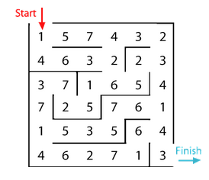
Maze 100 (91)
As you find a path through this maze add up each number you pass.
You aren’t allowed to retrace your steps.
Can you find a path that totals exactly 100?
Notes:
Example of LTHC task (see later), longer investigation

Slide 49
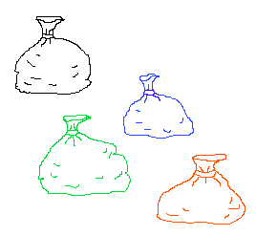
Money Bags (1116)
Ram divided 15 pennies among four small bags.
He labelled each bag with the number of pennies inside it.
He could then pay any sum of money from 1p to 15p without opening any bag.
How many pennies did Ram put in each bag?
Notes:
Extension - what amount they would need in a fifth bag to be able to make as many amounts as possible over 15p?
Possible generalisation powers of two i.e. bags of 1, 2, 4, 8, 16 etc.
LOOKING AT THE UNDERLYING STRUCTURE OF THE REASONING – WHAT DO YOU EXPECT THE CHILDREN TO BE SAYING? ELICIT CONTRIBUTIONS FROM DELEGATES.

Slide 50
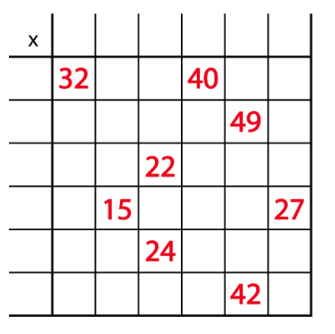
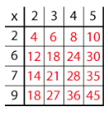
Mystery Matrix (1070)

Slide 51
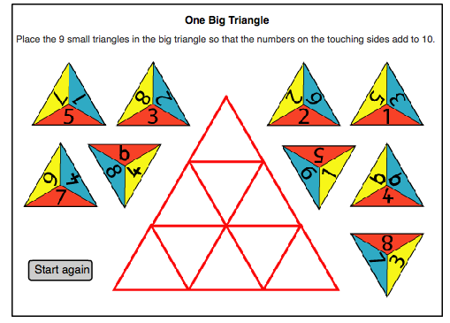
One Big Triangle (192)
Notes:
Show interactive on site – talk in pairs, how would you get started?
Reasoning that helps us get started is the challenging reasoning
Trial and improvement
What is the number sense here?

Slide 52
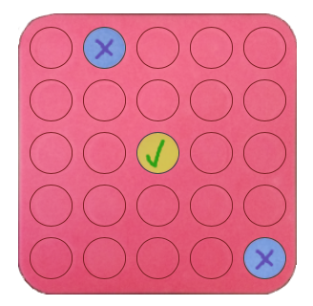
Poly Plug Rectangles (7511)
Notes:
Play Poly Plug introduction – part 1 video, then ask for noticings, wondering and questions to be discussed on tables.
Take some feedback and clarify whatever is needed to enable pairs to play one on one several times (”as your children might, to get into the game”).
Next ask them to set up their boards as shown at the start of the part 2 video, then play it and ask them to discuss whether they agree or not and why.
Perhaps replay the moves for themselves (you could document them with numbers on the flipchart as a reminder of the order) in order to see if ‘knowing’ was possible earlier?
Time for more play and encourage delegates to vary the number of counters (4 upwards), the position on the board and the orientation of the rectangle. Talk about outcomes - ”what does changing the number of counters do?” etc.
Watch last video and pause at . “Do you agree or disagree with the centre being a pointless guess?” (Reasoning could be “it is pointless because you know it will be there and therefore you’ve ‘wasted’ a guess”, or “it isn’t pointless because it will definitely be a hit!”) Highlight that this reasoning about pointless guesses can be key to developing reasoning skills – not just about was is, but also what isn’t.
If time, offer the opportunity to play pair on pair to develop the reasoning by rehearsing with your partner against the other ‘team’.

Slide 53
How would you support the children to generalise their thinking?
What would you be expecting? How might you develop their thinking?
How would you expect them to communicate their thinking? Verbally? In writing?

Slide 54
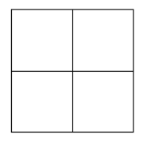
Reach 100 (1130)
This gives four numbers, one in each row (left to right) and one in each column
(top to bottom)
Draw a grid like this
Write a digit in each box
How many solutions can you find where
the four numbers add to 100 exactly?
5
2
1
9
Notes:
This total is 151

Slide 55
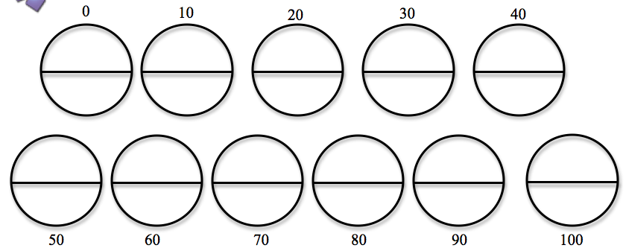
Reasoned Rounding (10945)
Notes:
Modelling with TA

Slide 56
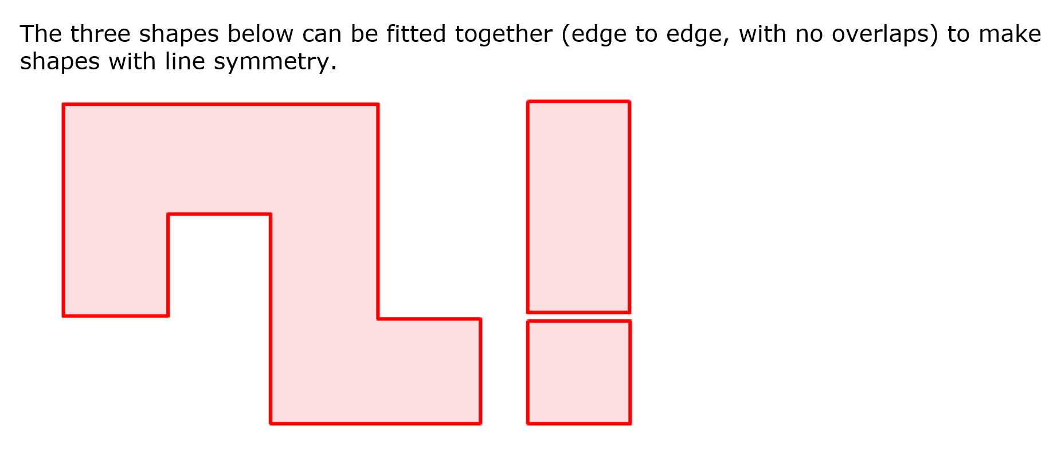
Reflecting Squarely (1840)
Notes:
Note no question shown – formulate question prac first then explain the task ie how many can you make
Allot time to try task then go to live site and allow time to consider students solution and strategic approach – allow time to continue exploring it, modelling idea of developing flexible approaches to non-routine problems ie building representations then seeing whats in common with other problems eg being systematic, reduing problem down to fewer elements to make it more manageable, then building it back up again…

Slide 57
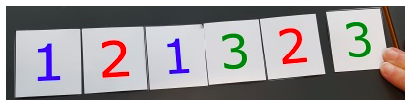
Sandwiches (522)
Start with two 1’s, two 2’s and two 3’s:
Can you arrange these digits in a line so that:
there is just one digit between the two 1s
there are just two digits between the two 2s
there are just three digits between the two 3s
Notes:
NEED DIGITS?
Alternative rich task at ‘lower’ entry level so that problem-solving skills can be focused on
NB extensions – just 1122 (impossible), then 11223344, then 1122334455 (impossible), 112233445566 (impossible), 11223344556677
(10 mins)

Slide 58
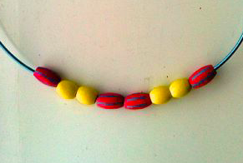
School Fair Necklaces (9692)
Rob and Jennie were making necklaces to sell at the school fair. They decided to make them very mathematical.
Each necklace was to have eight beads, four of one colour and four of another.
And each had to be symmetrical, like this:
How many different necklaces could they make?
Notes:
Refer back to ‘6 Beads’ after having tackled the problem.
Draw out the working systematically, all possibilities, proof by exhaustion.
Ask each table to represent a systematic way of working through the solutions with their counters.
Everyone to get up and look at other tables’ systems.

Slide 59

Sealed Solution (1177)
A set of ten cards, each showing one of the digits from 0 to 9, is divided up between five envelopes so that there are two cards in each envelope. The sum of the two numbers inside it is written on each envelope:
What numbers could be inside the "8" envelope?
Notes:
Have a go in pairs KS2 the solver and KS1 the recorder.
Then consider what the five stages of reasoning might look like in the context of this problem.

Slide 60
Shape Draw (10368)
This challenge is designed to be worked on in a small group.
Using the eight cards can you work out the shape that is being described?
Do you need all the information that was given? Can you explain how you know?

Slide 61
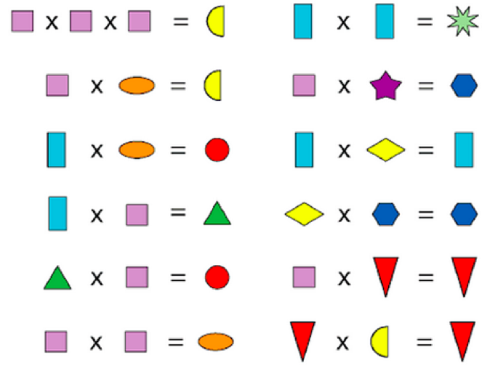
Shape Times Shape (5714)
The coloured shapes stand for eleven of the numbers from 0 to 12.
Each shape is a different number.
Can you work out what they are?

Slide 62
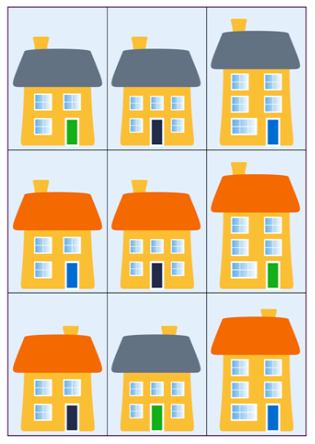
Sort the Street (5157)
Notes:
Activtiy for pre-Venn diagrams etc

Slide 63
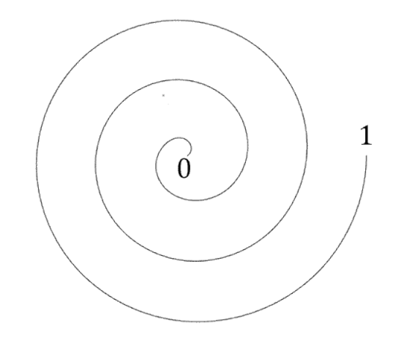
Spiralling Decimals (10326)
0.5 0.25 0.75 0.3
0.35 0.9 0.99 0.999
0.1 0.01 0.05 1.79
0.64 0.32 0.54 0.865
Notes:
This is a good ‘quick’ task that invoIves fIuency, reasoning and PS

Slide 64
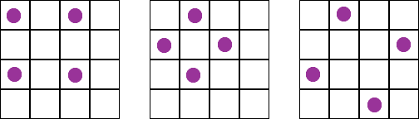
Square Corners (1142)
On each of these grids the counters lie at the four corners of a square:
What is the greatest number of counters you can place on a four by four grid without four of them lying at the corners of a square?
Notes:
Good follow-up to Square It.
What problem-solving skills did you use? (Trial and improvement)

Slide 65
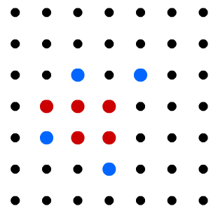
Seeing Squares (13125)
Notes:
Explain rules, play against computer using interactive, then play in pairs
Which is the best place to start? How do you know?
Can you find a sequence of moves that guarantees a win?
Which NC aims does this task help to support?
We feel it’s particularly good for PS
What problem-solving skills did you use? (See next slide)

Slide 66
Strike it Out (6589)
6 + 4 = 10
10 take away 9 makes 1
1 add 17 is 18
18……
Competitive aim – stop your partner from going
Collaborative aim – cross off as many as possible
Notes:
Going to use Strike It Out to explore the stages of reasoning further, in particular proof

Slide 67
Exploring proof
Is it possible to create a string of number sentences that uses all the numbers on the:
0-20 number line?
1-20 number line?
Any number line with a set of consecutive whole numbers?

Slide 68
0-20 number line
If zero is included in the number sentence then all three numbers are not distinct.
This is true whether you use addition or subtraction in your number sentence.
This does not obey the rules of the game.
Therefore, on 0-20 numberline we cannot ever use up all the numbers.

Slide 69
1-20 number line
The first number sentence uses up three distinct nos.
The second number sentence uses up 2 new nos.
The third number sentence uses up 2 more new nos.
The total number of numbers used so far is 3+2+2 = 7.
Each subsequent number sentence will use 2 more new nos.
Therefore, the total number of numbers used will go up in twos from seven.
The 1-20 numberline has 20 numbers on it.
Going up in 2s from 7 we will never get to 20 exactly – only 19 or 21.
Therefore, it is impossible to use exactly all the numbers on the 1-20 numberline.

Slide 70
Any numberline
The first number sentence uses an odd number of distinct nos.
Each subsequent number sentence uses an even number of distinct new nos.
Odd + any number of even numbers is always odd.
Therefore the total number of numbers used is always odd.
Therefore we will never be able to use all the numbers on any numberline that has an even number of consecutive distinct numbers on it.
However, this does not prove that we can always use all the numbers on a numberline with an odd number of consecutive distinct numbers.
We only know that we have the correct number of numbers to make it a possibility but not a certainty.
This does not give us any insight into the individual number sentences and the order in which the numbers need to be used.

Slide 71
What are the features of proof by logical reasoning?
Notes:
Include:
Ask whether the steps follow ‘logically’, each building on previous steps.
Are they complete are some assumptions made
Check that the final statement is indeed what the reasoning set out to prove.

Slide 72

Stringy Quads (2913)
Can you make a quadrilateral which has exactly one line of symmetry? And another? And another? …
How could you convince someone else that your shape has just one line of symmetry?
Try again, but this time answer the same questions for a quadrilateral with exactly two lines of symmetry … exactly three lines of symmetry… exactly four lines of symmetry.

Slide 73




Slide 74
Three Neighbours (8108)
Take three numbers that are ‘next door neighbours’ when you count. These are called consecutive numbers.
Add them together. What do you notice?
Take another three consecutive numbers and add them together. What do you notice?
Can you prove that this is always true by looking at/thinking about your examples?

Slide 75


Notes:
What do we think of these in terms of proof? And in terms of reasoning?
No visual proof submitted…yet!

Slide 76

Totality (1216)
Notes:
Ask participants to make a list on their table of the problem-solving skills they use as they tackle the tasks in this session
Totality – LTHC and task that you could return to

Slide 77

Two-digit Targets (6343)
You have a set of the digits from 0-9.
Can you arrange these digits into the boxes to make five two-digit numbers as close to the targets as possible? You may use each digit once only.

Slide 78
Unequal Averages (11281)
Here’s an interesting set of five numbers:
2,5,5,6,7
Can you find other sets of five positive whole numbers where:
Mean = Mode = Median = Range

Slide 79
Can you find sets of five positive whole numbers that satisfy the following properties?
Mode < Median < Mean
Mode < Mean < Median
Mean < Mode < Median
Mean < Median < Mode
Median < Mode < Mean
Median < Mean < Mode
Show that some of them can be satisfied with sets of just four numbers.
Not all of these can be satisfied by sets of five numbers!
Can you explain why?
Show that all of them can be satisfied with sets of six numbers.

Slide 80

Wallpaper (4964)
Notes:
Good for thoughtfulness
Arrange these pieces of wallpaper in order of size. Put the smallest first. How did you do it?

Slide 81

What’s it Worth? (1053)
Each symbol has a numerical value. The total for the symbols is written at the end of each row and column.
Can you find the missing total that should go where the question mark has been put?

Slide 82

Which Scripts? (774)
Six numbers in five
different scripts.
Can you decipher
the scripts?
What are the six
numbers?
Notes:
Liz

Slide 83

6 Beads (152)
If you put three beads onto a tens/ones abacus you could make the numbers 3, 30, 12 or 21.
Explore the numbers you could make using 6 beads.
Notes:
Have counters available
Give out large sheets with abacus already drawn, ask pairs to record one solution
Invite them to come out, order them, impose system. Helps children understand what is meant by ‘working systematically’
Proof by exhaustion
Number sense?

